Slide 1
Time Series Analysis of Cryptocurrencies
Omkar Mutreja
Ananya Bhupathipalli
Mohammed Farees Patel

Slide 2
OBJECTIVE
Providing investment strategies for Cryptocurrencies using time series modeling and forecasting methods

Slide 3
Cryptocurrencies used for Analysis:
Bitcoin
Ethereum
Litecoin
Ripple
Monero
Dash

Slide 4
TIME SERIES PLOTS
Ethereum – Red
Lite coin – Green
Ripple – Black
Monero – Cyan
Dash - Blue

Slide 7
Correlation Analysis
Top 5 correlation pairs are:
Monero ~ Dash ~ 0.985
Monero ~ Lite coin ~ 0.974
Monero ~ Bitcoin ~ 0.969
Dash ~ Lite coin ~ 0.969
Lite coin ~ Bitcoin ~ 0.956

Slide 8
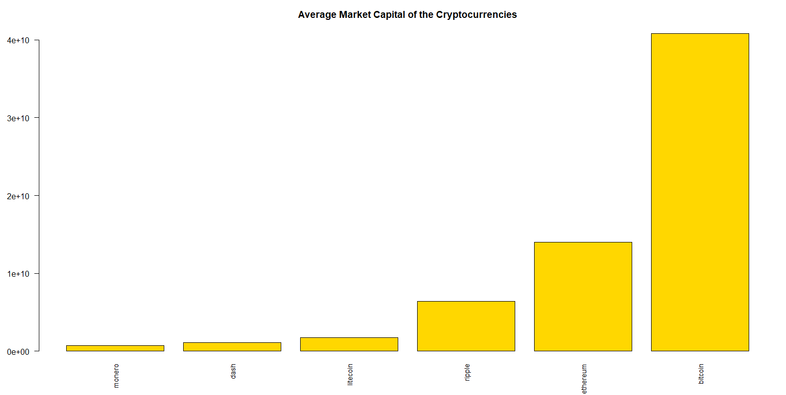
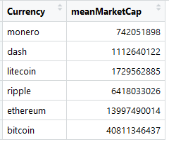
Market Capital Analysis

Slide 9
Co-Integration Series
Below is the co-integration series for all the six cryptocurrencies:
cryptocurrency$Close.bitcoin +
4.33*cryptocurrency$Close.ethereum +
23.70*cryptocurrency$Close.litecoin - 1995.25*cryptocurrency$Close.ripple -
19.94*cryptocurrency$Close.monero - 14.46*cryptocurrency$Close.dash

Slide 10
Co-Integration Series

Slide 11
Thank You

